Slide 1
Day 05
Forward Kinematics

Slide 2
Links and Joints
n joints, n + 1 links
link 0 is fixed (the base)
joint i connects link i – 1 to link i
link i moves when joint i is actuated
joint n
joint 3
joint 4
joint n-1
link 3
.................
joint 1
link 2
link n-1
link 1
link n
joint 2
link 0

Slide 3
Forward Kinematics
given the joint variables and dimensions of the links what is the position and orientation of the end effector?
p⁰ ?
a₂
θ₂
y₀
a₁
θ₁
x₀

Slide 4
Forward Kinematics
because the base frame and frame 1 have the same orientation, we can sum the coordinates to find the position of the end effector in the base frame
(a₁ cos θ₁ + a₂ cos (θ₁ + θ₂),
a₁ sin θ₁ + a₂ sin (θ₁ + θ₂) )
y₁
a₂
( a₂ cos (θ₁ + θ₂),
a₂ sin (θ₁ + θ₂) )
θ₂
y₀
θ₁
a₁
x₁
θ₁
( a₁ cos θ₁ , a₁ sin θ₁ )
x₀

Slide 5
Forward Kinematics
from Day 02
p⁰ = (a₁ cos θ₁ + a₂ cos (θ₁ + θ₂),
a₁ sin θ₁ + a₂ sin (θ₁ + θ₂) )
y₂
x₂
x₂ = (cos (θ₁ + θ₂),
sin (θ₁ + θ₂) )
y₂ = (-sin (θ₁ + θ₂),
cos (θ₁ + θ₂) )
a₂
θ₂
y₀
θ₁
a₁
θ₁
x₀

Slide 6
Frames
y₂
x₂
y₁
a₂
θ₂
y₀
x₁
a₁
θ₁
x₀

Slide 7
Forward Kinematics
using transformation matrices

Slide 8
Links and Joints
n joints, n + 1 links
link 0 is fixed (the base)
joint i connects link i – 1 to link i
link i moves when joint i is actuated
joint n
joint 3
joint 4
joint n-1
link 3
.................
joint 1
link 2
link n-1
link 1
link n
joint 2
link 0

Slide 9
Forward Kinematics
attach a frame {i} to link i
all points on link i are constant when expressed in {i}
if joint i is actuated then frame {i} moves relative to frame {i - 1}
motion is described by the rigid transformation
the state of joint i is a function of its joint variable q_{i} (i.e., is a function of q_{i})
this makes it easy to find the last frame with respect to the base frame

Slide 10
Forward Kinematics
more generally
the forward kinematics problem has been reduced to matrix multiplication

Slide 11
Forward Kinematics
Denavit J and Hartenberg RS, “A kinematic notation for lower-pair mechanisms based on matrices.” Trans ASME J. Appl. Mech, 23:215–221, 1955
described a convention for standardizing the attachment of frames on links of a serial linkage
common convention for attaching reference frames on links of a serial manipulator and computing the transformations between frames

Slide 12
Denavit-Hartenberg

Slide 13
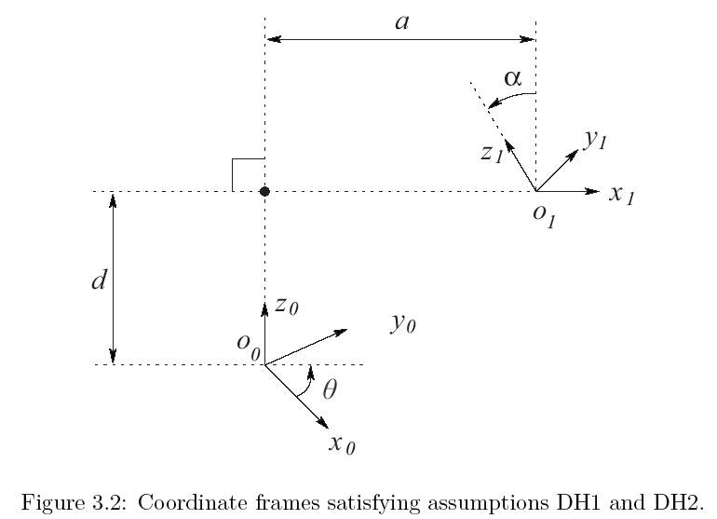
Denavit-Hartenberg

Slide 14
Denavit-Hartenberg
notice the form of the rotation component
this does not look like it can represent arbitrary rotations
can the DH convention actually describe every physically possible link configuration?

Slide 15
Denavit-Hartenberg
yes, but we must choose the orientation and position of the frames in a certain way
(DH1)
(DH2)
claim: if DH1 and DH2 are true then there exists unique numbers

Slide 16
Denavit-Hartenberg
proof: on blackboard in class

